Slide 1
Bacterial Nutrition and ECONOMIC IMPORTANCE
DR.SONAL MISHRA

Slide 2
Autotrophic and Heterotrophic
Autotrophic – organisms which make their own food
Heterotrophic – organisms which take in food made by other organisms

Slide 3
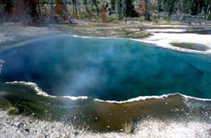
Autotrophic Bacteria
Photosynthetic bacteria
Use light energy to make food
E.g. purple sulphur bacteria

Slide 4
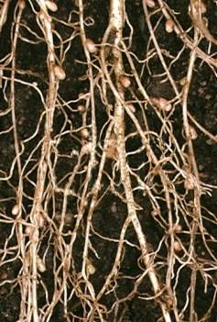
Autotrophic Bacteria
Chemosynthetic bacteria
Use energy from chemical reactions to make food
E.g. Nitrifying bacteria that convert ammonia to nitrates in the nitrogen cycle

Slide 5
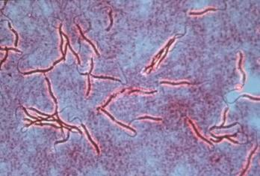
Heterotrophic Bacteria
Saprophytic Bacteria
Live off dead organic matter
E.g. bacteria of decay in the soil

Slide 6
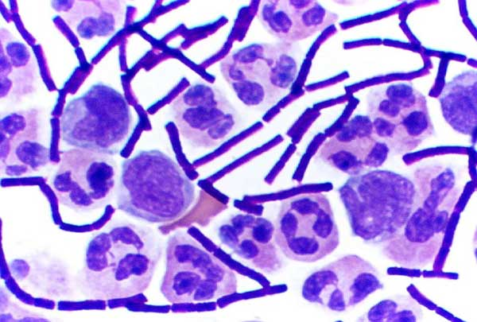
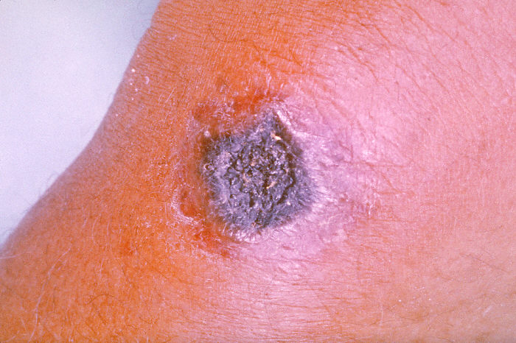
Heterotrophic Bacteria
Parasitic Bacteria
Take food from live host
Some cause diseases
E.g. Bacillus anthracis
causes anthrax

Slide 7
Bacterial Nutrition

Slide 8
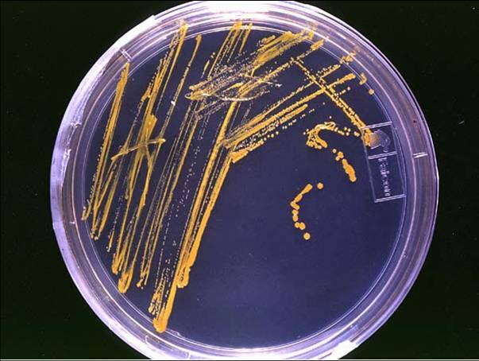
Factors affecting the growth of bacteria
For the maximum growth rate bacteria must have access to a food source and the conditions of their environment must be monitored closely

Slide 9
Factors affecting the growth of bacteria
Too much or too little of any of the following factors will slow down the growth of bacteria:
Temperature
Oxygen concentration
pH
External solute concentration
Pressure

Slide 10
Temperature
Most bacteria grow well between 20°C and 30°C.
Some can tolerate much higher temperatures without their enzymes becoming denatured.
Low temperatures slow down the rate of reaction of enzymes resulting in slower growth.
pH
If a bacterium is placed in an unsuitable pH its enzymes will become denatured.

Slide 11
Temperature
Most bacteria grow well between 20°C and 30°C.
Some can tolerate much higher temperatures without their enzymes becoming denatured.
Low temperatures slow down the rate of reaction of enzymes resulting in slower growth

Slide 12
pH
If a bacterium is placed in an unsuitable pH its enzymes will become denatured

Slide 13
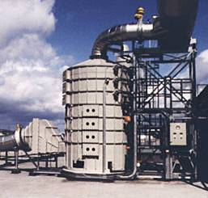
Oxygen concentration
Aerobic bacteria require oxygen for respiration e.g. Streptococcus
This is why oxygen is sometimes bubbled through bioreactors

Slide 14
Oxygen concentration
Anaerobic bacteria do not require oxygen to respire
  Facultative anaerobes can respire with or without oxygen e.g. E.Coli (found in intestines)
  Obligate anaerobes can only respire in the absence of oxygen e.g. Clostridium tetani (causes tetanus)

Slide 15
External Solute concentration
Bacteria can gain or lose water by osmosis
If the external solute concentration is
  higher than the bacterial cytoplasm water will move out of the bacteria (Dehydration)
  Food preservation techniques are based on this

Slide 16
External Solute concentration
Bacteria can gain or lose water by osmosis
If the external solute concentration is
  lower than the bacterial cytoplasm solute concentration water will enter the bacteria
  Cell wall will prevent bursting in most cases

Slide 17
Pressure
The growth of most bacteria is inhibited by high pressures.
Some bacteria can withstand high pressures. Pressure tolerant bacteria for use in bioreactors can be formed by genetic engineering techniques.

Slide 18
Economic importance of bacteria
Beneficial bacteria
Bacteria such as Lactobacillus are used to convert milk to products such as cheese and yoghurt
Genetically modified bacteria e.g. E. Coli are used to make products such as insulin, enzymes, drugs, food flavourings and vitamins

Slide 19
Economic importance of bacteria
Harmful bacteria
Micro-organisms that cause disease are called pathogens
E.g. Bacillus anthracis causes anthrax in humans
If they enter the body through a wound they can multiply and effect the nerves and activity of muscles
Other bacterial diseases include tuberculosis, typhoid, cholera, diphtheria and brucellosis

Slide 20
Beneficial and harmful bacteria
BENEFICIAL
Lactobacillus converts milk to yoghurt and cheese
Antibiotics can be formed by some microorganisms
Bacteria in the colon help produce vitamins
G.M.O.’s are used to make insulin and other useful compounds
Bacteria are active in the Carbon and Nitrogen Cycles
HARMFUL
Pathogenic Bacteria can cause diseases in humans and animals.
Pathogenic Bacteria can cause diseases in plants.
Bacteria can cause food spoilage
Bacteria can cause tooth decay.

Slide 21
THANKS

